Slide 1
Single-Phase Induction Motor
Dr. Ramaprasad Panda

Slide 2
INTRODUCTION
There are two basic reasons for the use of single-phase motors rather than 3-phase motors.
For reason of economy, most houses, offices and also rural areas are supplied with single phase a.c, as power requirements of individual load items are rather small.
Fixed loads requiring not more than 0.5KW can generally be served most economically with single phase power and a single phase motor.
Single phase motors are simple in construction, reliable, easy to repair and comparatively cheaper in cost and therefore, find wide use in fans, refrigerators, vacuum cleaners, washing machines, other kitchen equipment, tools, blowers, centrifugal pumps, small farming appliances etc.

Slide 3
Types of Single-Phase Induction Motor
These are classified into different types depending upon the different starting methods. They are
Split Phase Induction motor
Capacitor Start Induction motor
Capacitor Start capacitor-run Induction motor
Permanent Capacitor
Shaded Pole type
The required motors are selected depending upon required staring and running torque, starting and running currents drawn from the supply and duty cycle.

Slide 4
Applications
Applications:
Single phase induction motors are in very wide use in industry especially in fractional horse-power field.
They are extensively used for electrical drive for low power constant speed apparatus such as machine tools, domestic apparatus and agricultural machinery in circumstances where a three-phase supply is not readily available.
Single phase induction motors sizes vary from 1/400 kw to 1/25 kw are used in toys, hair dryers, vending machines etc.
Universal motor is widely used in portable tools, vacuum cleaners& kitchen equipment.

Slide 5
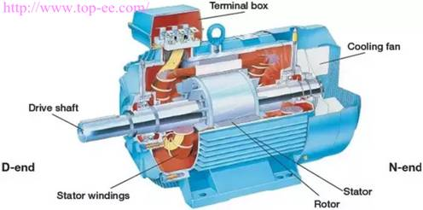
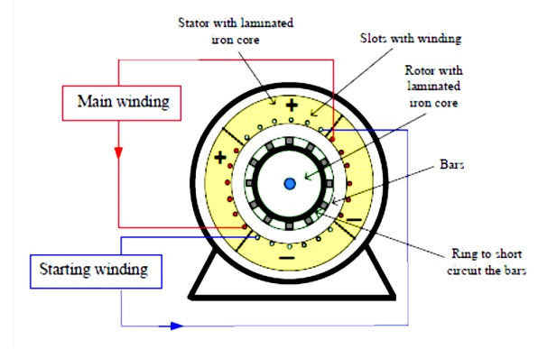
CONSTRUCTION
Single phase induction motor is very simple and robust in construction.
The stator carries a distributed winding in the slots cut around the inner periphery.
The rotor is invariably of the squirrel cage type.
In practice, in order to convert temporarily the single phase motor into two-phase motor, auxiliary conductors are placed in the upper layers of stator slots.
The auxiliary winding has a centrifugal switch in series with it. The function of the switch is to cut off the starting winding, when the rotor has accelerated to about 75% of its rated speed.

Slide 6
WORKING OF SINGLE-PHASE INDUCTION MOTOR
A single phase induction motor is inherently not self-staring can be shown easily.
Operation is based on double field rotating theory.
The basic idea behind the double field revolving theory is that any alternating quantity can be resolved into 2 equal components rotating in opposite direction. ... The interaction with two rotating fluxes produces torque in opposite direction, leading net torque to zero. Thus making 1ph IM non-self starting.
However, if the rotor is started somehow, say, in the clockwise direction, the clockwise torque starts increasing and, at the same time, the anticlockwise torque starts decreasing. Hence, there is a certain amount of net torque in the clockwise direction which accelerates the motor to full speed.
It shows that single phase IM is not self starting

Slide 7
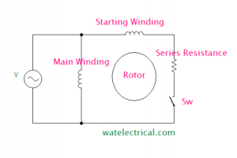
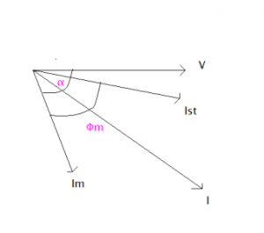
Split-Phase
In Split-phase IM, a resistance is connected in series with the starting winding. So, it is also called as resistance-start IM. A switch (SW) is also connected in series with the winding to switch off after the rotor has attained running speed. The main winding and the starting winding or auxiliary winding are displaced at an angle 90 degrees to each other.
The main winding has low resistance and high reactance whereas the auxiliary winding has high resistance and low reactance value.
From the phasor diagram, we can understand that the main field current lags the voltage by an angle. But due to the starting winding, the starting current phasor angle decreases. It is almost in the phasor with the voltage. So, an initially high starting torque can be developed.

Slide 8
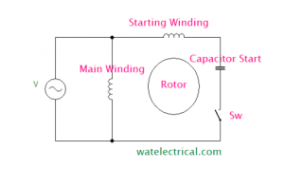
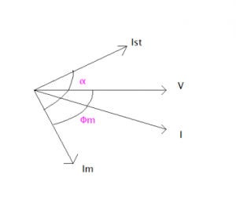
Capacitor Start Induction Motor
A capacitor is connected in series with the starting winding associated with a centrifugal switch. This capacitor is used to start the motor initially until it attains sufficient speed, after that the capacitor is disconnected by opening the switch.
From the phasor diagram, we can understand that the starting winding will be leading the voltage as it is capacitive nature due to the introduction of a capacitor. The starting torque would be high and with improved power factor. But poor running torque due to the removal of a capacitor using a switch after the rotor initiation.

Slide 9
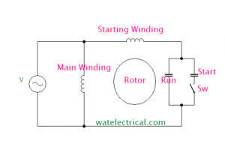
Capacitor Start Capacitor-Run Induction Motor
A capacitor is connected in series with the starting winding associated with a centrifugal switch and also a capacitor is connected in parallel to the starting capacitor. This capacitor is used to start the motor initially until it attains sufficient speed, after that the capacitor is disconnected by opening the switch. But the capacitor connected in parallel remains as it is to improve the running conditions.
The starting torque would be high and with improved power factor and the running torque is also good. The running torque is good because though the starting capacitor is switched off, the running capacitor remains operating to maintain good torque.

Slide 10
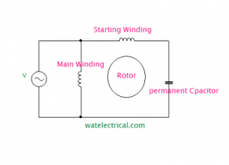
Permanent Capacitor
A capacitor is connected in series with the starting winding and is not associated with a centrifugal switch. This capacitor is used to start the motor initially and it also remains during the running conditions to improve the performance.
as the capacitor is used permanently in series with the starting winding. The starting and running torque corresponding to the permanent capacitor motor is good.

Slide 11
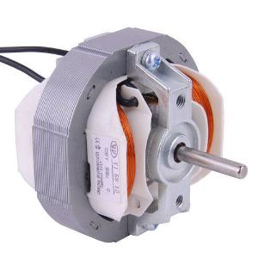
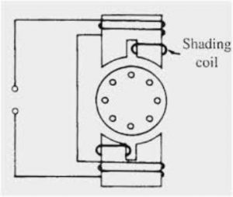
Shaded Pole
The shaded pole IM consists of a squirrel cage rotor which is rotated under the salient pole magnetic field. ON end of the salient pole is attached by a copper coil which is also considered as a shaded ring which is short-circuited.
The magnetic field induced in the main poles is induced into the shaded coil by means of an Induction Principle. The magnetic flux produced is an alternating field. The flux induced in the shaded coil opposes the flux of the main pole. During the positive cycle, the flux opposition is more towards the main field and vice-versa during the negative cycle. Thus, a rotating magnetic field is developed due to the field oppositions during the entire cycle. Therefore, a unique torque is developed which is able to rotate the rotor. This is the working of how it is a self-starting motor. T

Slide 12
Applications of Different Types of Single-Phase Induction Motor
Split-Phase
These are used for starting loads such as fans, blower-fans, mixer-grinders, and washing machines.
Capacitor Start
These are used at heavy load applications such that where frequent starting is required.
Used in air conditioners, compressors of Refrigerators, conveyor belts, and other machine applications.
Capacitor Start Capacitor Run
These are used in heavy load applications and also where frequent starting and high inertia is required.
Used in air conditioners, refrigerators, and pumps.

Slide 13
Applications cont……
Permanent Capacitor
This Motor has high efficiency and improved power factor. These are used in fans, blowers, air conditioners, and compressors in refrigerators.
Shaded Pole Type
These are used for low starting applications such as in cooling fans, exhaust fans, blowers, fans of different types, relays, and in table fans.
Cheap
No need for an external source
Self-starting

Slide 14
Disadvantages of Single-Phase Induction Motor
Their output is only 50% of the three-phase motor, for a given frame size and
temperature rise.
They have lower power factor.
Lower efficiency.
These motors do not have inherent starting torque.
More expensive than three-phase motors of the same output.
Low overload capacity.
we had an overview of a one-phase IM, it is a machine that works on the principle of electromagnetic induction. This RMF is developed by certain starting methods which enables the motor to self-start by itself.

